Slide 1

AI vs Human — Interactive Sentiment Guessing Game
Presented by - Mohammed Haroon Palagiri
001

Slide 2
THE GAMES
001
002
003
004
005
006
INTRODUCTION
OBJECTIVE
WORKFLOW
MACHINE LEARNING COMPONENT
GAME
RESULTS & OBSERVATIONS

Slide 3
01
Introduction

Slide 4
THE PLAYERS
001
003
002
Most sentiment analysis projects focus on accuracy metrics, model performance, or static dashboards — which can be technical and not very engaging for general audiences.
The goal is to make machine learning engaging, intuitive, gamified, and easy for anyone to understand, regardless of technical background.
Sentiment analysis
is one of the
most widely used NLP techniques for understanding customer opinions, feedback, and emotions in business
This project reimagines sentiment analysis as a fun, interactive Human vs AI guessing game, making the learning experience more dynamic.
004
001
002
003

Slide 5
02
Objective

Slide 6
ARE YOU READY?
Build an interactive Streamlit web application where users compete against an AI model to guess the sentiment of real customer reviews.

Slide 7
ORDER
START
01
02
03
Upload Review Dataset
Random sample a review each round
Compare three Sentiments
Allows flexibility and works with multiple types of review data.
Ensures unpredictability and keeps the game engaging
- Human Guess
- AI Guess
- True Sentiment Label

Slide 8
ORDER
Follow up
04
05
06
Track Scores
Scoreboard & Winner
Restart Game
Displays how often the user or AI is correct, and how often they agree
Declares Whether the human or AI Won the game.
Reset rounds and scores for replayability

Slide 9
03
Workflow

Slide 10
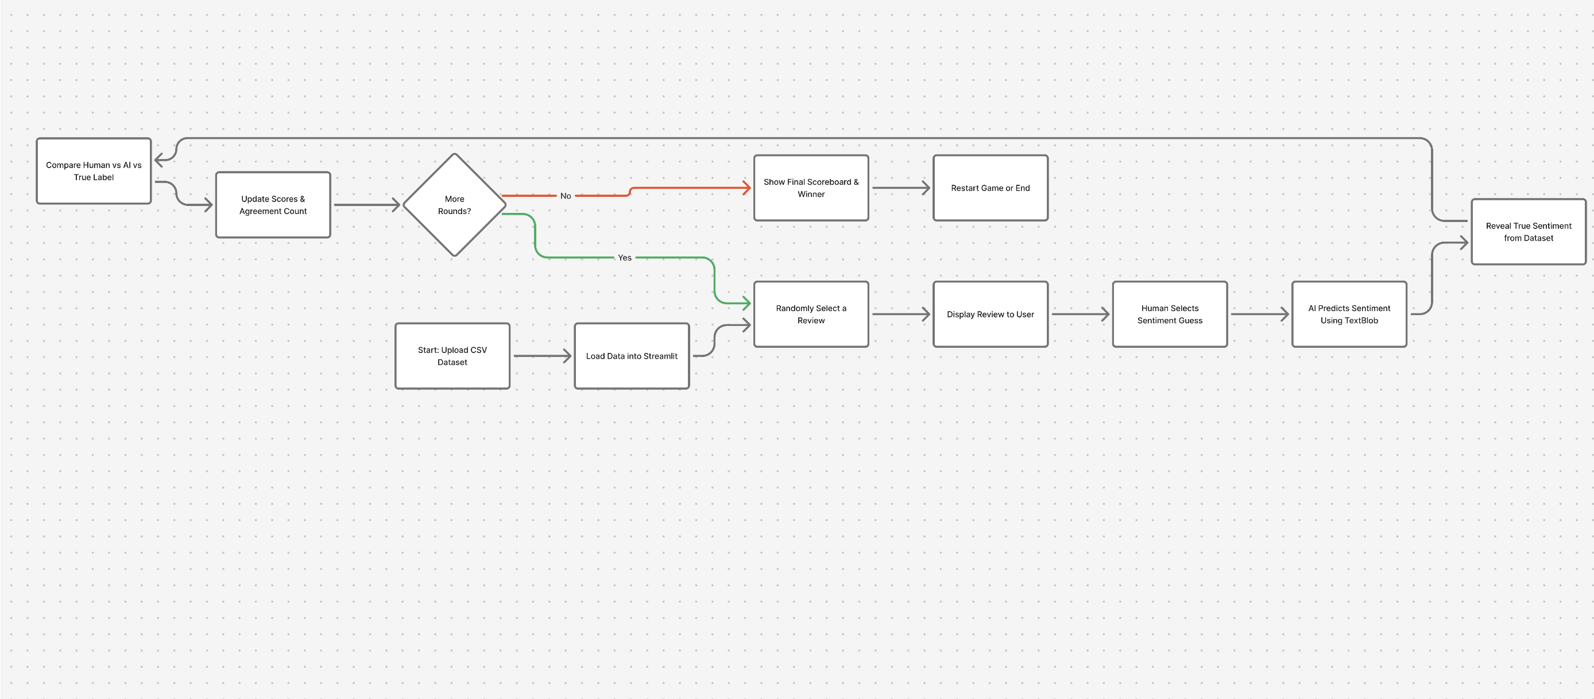
Workflow
Upload CSV → Random Review → Human Guess → AI Guess → True Label → Compare → Scoreboard → Next Round → Final Result

Slide 11
04
Machine Learning

Slide 12
WHO IS WHO
002
AI MODEL USED
Why TextBlob?
TextBlob Sentiment Analyzer
Uses polarity-based rules to classify text as Positive, Neutral, or Negative
Lightweight, fast, and ideal for interactive applications
No training or GPU required
Quick & interpretable predictions
Zero training overhead
Perfect for a fun, round-based game
Works well on short reviews and simple emotional expressions

Slide 13
WHO IS WHO
002
AIHow the AI Predicts Sentiment MODEL USED
Limitations
Takes the selected review text
Computes polarity score (range: -1 to +1)
Maps polarity to sentiment label:
  > 0.1 → Positive
  < -0.1 → Negative
  Otherwise → Neutral
Returns AI’s guess for comparison with:
Human guess
True sentiment from dataset
Not as powerful as BERT/transformers
Struggles with:
Sarcasm
Ambiguous text
Mixed sentiments
Depends on polarity thresholds

Slide 14
05
GAME

Slide 15
Let’s Play

Slide 16
06
Results & Observations

Slide 17
Observations
The AI matched the true sentiment label consistently when polarity was clear.
Humans showed strength in understanding:
  Context
  Tone
  Real-world meaning
Key Results
User Engagement Observations
The game successfully demonstrated how humans and AI interpret sentiment differently.
AI performed very well on clear positive and negative reviews.
Human players did better on:
Sarcasm
Emotional text
Mixed or ambiguous sentences
Human vs AI
The game format made NLP concepts easy for anyone to understand.
Real-time feedback (scores, agreements, predictions) increased engagement.
The restart feature enabled multiple rounds and captured different outcomes.

